Slide 1
Lecture 7 Binary search trees
EECS-214

Slide 2
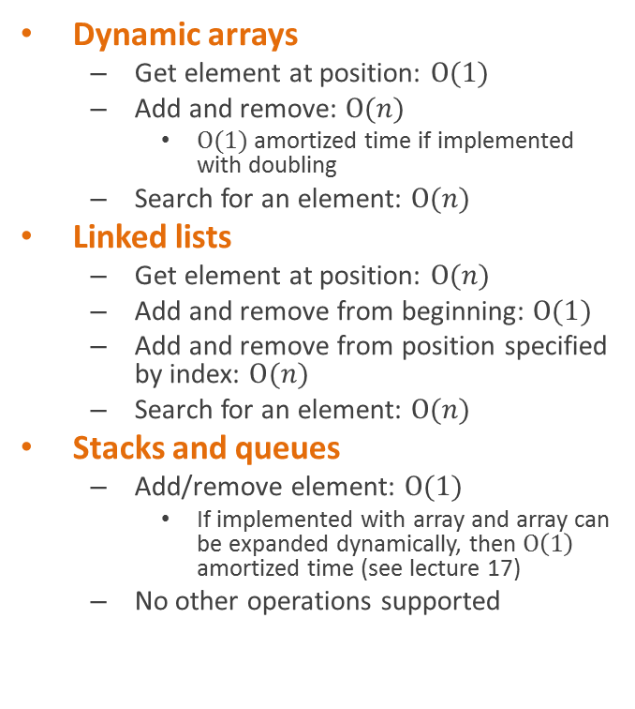

Representing collections of objects
We’ve been looking at collection classes
Store a bunch of objects
Different flavors support
Different kinds of operations
With different performance trade-offs
Notice these are all bad at searching
All take
Or don’t support it al all
Can we do better?
Dynamic arrays
Get element at position: $O(1)$
Add and remove: $O(n)$
$O(1)$ amortized time if implemented with doubling
Search for an element: $O(n)$
Linked lists
Get element at position: $O(n)$
Add and remove from beginning: $O(1)$
Add and remove from position specified by index: $O(n)$
Search for an element: $O(n)$
Stacks and queues
Add/remove element: $O(1)$
If implemented with array and array can be expanded dynamically, then $O\left(1\right)$ amortized time (see lecture 17)
No other operations supported

Slide 3
Binary trees
Common case
Fixed branching factor of 2
Every node has at most 2 children
Referred to as the left child and right child

Slide 4
Inorder traversal
Inorder(node) {
Inorder(node.leftChild)
print node
Inorder(node.rightChild)
}
Output:
1
2
3
4
5
6
7

Slide 5
Inorder traversal
Inorder(node) {
Inorder(node.leftChild)
print node
Inorder(node.rightChild)
}
Output:
1 3 2 6 5 7 4
1
2
3
4
5
6
7

Slide 6
Binary search trees
8
Binary tree
Each node labeled with a value
Number, string, or some other set that has a total order on it
Has the magic binary search tree property
2
9
1
6
4
7
3
5

Slide 7
Binary search trees
8
Binary tree
Each node labeled with a value
Number, string, or some other set that has a total order on it
Has the magic binary search tree property
For any node
2
9
1
6
4
7
3
5

Slide 8
Binary search trees
8
Binary tree
Each node labeled with a value
Number, string, or some other set that has a total order on it
Has the magic binary search tree property
For any node
All the nodes in the left subtree have labels ≤ to its label
2
9
1
6
4
7
3
5

Slide 9
Binary search trees
8
Binary tree
Each node labeled with a value
Number, string, or some other set that has a total order on it
Has the magic binary search tree property
For any node
All the nodes in the left subtree have labels ≤ to its label
All the nodes in the right subtree have labels ≥ to its label
2
9
1
6
4
7
3
5

Slide 10
Proposition
8
An in-order traversal of a binary search tree prints the nodes in sorted order
2
9
1
6
4
7
3
5

Slide 11
Proposition
8
Proof (by induction)
True for trees of depth 1
Assume it’s true for trees of depth n (for some n)
Consider a tree of depth n+1
A traversal of the tree will print:
An in-order traversal of the left subtree
The root
An in-order traversal of the right subtree
By assumption, the subtrees are printed in sorted order
And the root is
≥ anything on the left
≤ any on the right
So the whole thing is sorted
So the proposition holds for a tree of any depth
2
9
1
6
4
7
3
5

Slide 12
Representing binary search trees
8
class BST {
int key; BST parent;
BST left; BST right;
public BST(int k) { key = k;
// other fields null
}
}
2
9
1
6
4
7
3
5

Slide 13
tree search

Slide 14
Searching a binary search tree (pseudocode)
8
// Search tree starting at node
// Return node containing key k
// Or null if k missing from tree
Search(node, int k) {
if (node == null)
// Failure: not in tree
return null;
else if (k == node.key)
// Success: found it
return node;
else if (k < node.key)
return Search(node.left, k);
else
return Search(node.right, k); }
2
9
1
6
4
7
3
5

Slide 15
111 review: What do we call this kind of recursion?
8
Search(node, int k) {
if (node == null)
// Failure: not in tree
return null;
else if (k == node.key)
// Success: found it
return node;
else if (k < node.key)
return Search(node.left, k);
else
return Search(node.right, k); }
2
9
1
6
4
7
3
5

Slide 16
Tail recursion
Tail recursions are where all the recursive calls are of the form “return Search(…)”
All the procedure will do when it gets the result
Is forward it on to its caller
Search(node, int k) {
if (node == null)
// Failure: not in tree
return null;
else if (k == node.key)
// Success: found it
return node;
else if (k < node.key)
return Search(node.left, k);
else
return Search(node.right, k); }

Slide 17
Tail recursion
Tail recursions are where all the recursive calls are of the form “return Search()”
All the procedure will do when it gets the result
Is forward it on to its caller
Tail-call optimization
Don’t bother making a new stack frame for the new call
Just reuse the existing stack frame
And jump back to the beginning of the procedure
Search(node, int k) {
start: if (node == null)
// Failure: not in tree
return null;
else if (k == node.key)
// Success: found it
return node;
else if (k < node.key)
{ node = node.left; goto start; }
else
{ node = node.right; goto start; } }

Slide 18
Tail recursion
But of course, goto is evil
Makes code hard to read
Hard to maintain
Your coworkers will put not be pleased with you
Search(node, int k) {
start: if (node == null)
// Failure: not in tree
return null;
else if (k == node.key)
// Success: found it
return node;
else if (k < node.key)
{ node = node.left; goto start; }
else
{ node = node.right; goto start; } }

Slide 19
Tail recursion
But of course, goto is evil
Makes code hard to read
Hard to maintain
Your coworkers will put not be pleased with you
So we just rewrite it as a while loop
This is why 111 called tail recursions “iterations”
They’re the set of iterations that can be rewritten as while loops
Good C compilers, like gcc do this automatically
Search(node, int k) {
while (node != null) {
if (k == node.key)
// Success: found it
return node;
else if (k < node.key)
node = node.left;
else
node = node.right;
}
// Failure: not in tree
return null; }

Slide 20
Tail recursion
We can even simplify it a little more
Search(node, int k) {
while (node != null && node.key != k) if (k < node.key) node = node.left; else node = node.right;
return node; }

Slide 21
performance

Slide 22
Analysis
How do we analyze the running time of this algorithm?
Search(node, int k) {
while (node != null && node.key != k) if (k < node.key) node = node.left; else node = node.right;
return node; }

Slide 23
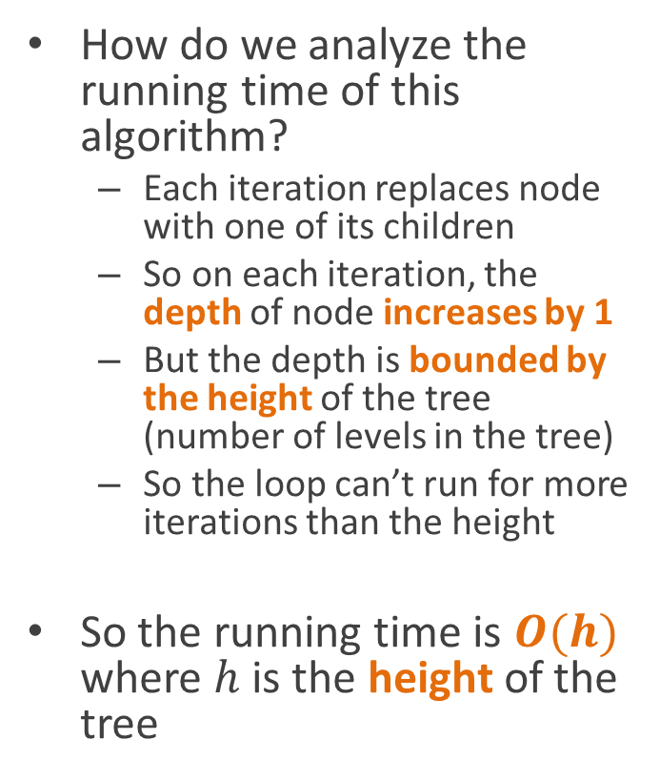
Analysis
How do we analyze the running time of this algorithm?
Each iteration replaces node with one of its children
So on each iteration, the depth of node increases by 1
But the depth is bounded by the height of the tree (number of levels in the tree)
So the loop can’t run for more iterations than the height
So the running time is $O(h)$ where $h$ is the height of the tree
Search(node, int k) {
while (node != null && node.key != k) if (k < node.key) node = node.left; else node = node.right;
return node; }

Slide 24
A bad tree to search
1
2
3
4
5
6
7
In the worst case, a tree is effectively a linked list

Slide 25
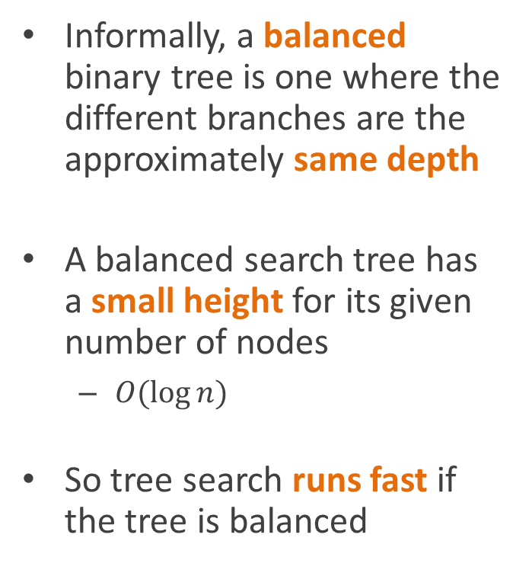
A good tree to search
Informally, a balanced binary tree is one where the different branches are the approximately same depth
A balanced search tree has a small height for its given number of nodes
$O(\log{n)}$
So tree search runs fast if the tree is balanced
4
2
6
1
3
5
7

Slide 26
A good tree to search
The most balanced tree is a complete binary tree
All leaves at same depth
All other nodes have both left and right children
We’ll talk next time about strategies for self-balancing trees
4
2
6
1
3
5
7

Slide 27
other operations

Slide 28
Special-case searches
// Get the node holding // the minimum value // in the tree
Minimum(n) {
while (n.left != null)
n = n.left;
return n;
}
// Get the node holding // the maximum value // in the tree
Maximum(n) {
while (n.right != null)
n = n.right;
return n;
}

Slide 29
Successor
Sometimes you want to find the node that would come after this one in an in-order traversal
Simulate what an in-order walk would do at this point
Successor(n) {
if (n.right != null) return Minimum(n.right);
p = n.parent;
while (p != null && n == p.right) {
n = p;
p = n.parent;
}
return p;
}

Slide 30
Successor
Two cases:
If we have a right child
In-order would go to the right child
Which would go to its left child
Which would go to its left child
Etc., until we get to a leaf
We can do all the with Minimum
Successor(n) {
if (n.right != null) return Minimum(n.right);
p = n.parent;
while (p != null && n = p.right) {
n = p;
p = n.parent;
}
return p;
}

Slide 31
Successor
Two cases:
If we have a right child
No right child
Have to move up
But how far?
Until we find an ancestor node for whom we are a left descendant, not a right descendant
Successor(n) {
if (n.right != null) return Minimum(n.right);
p = n.parent;
while (p != null && n == p.right) {
n = p;
p = n.parent;
}
return p;
}

Slide 32
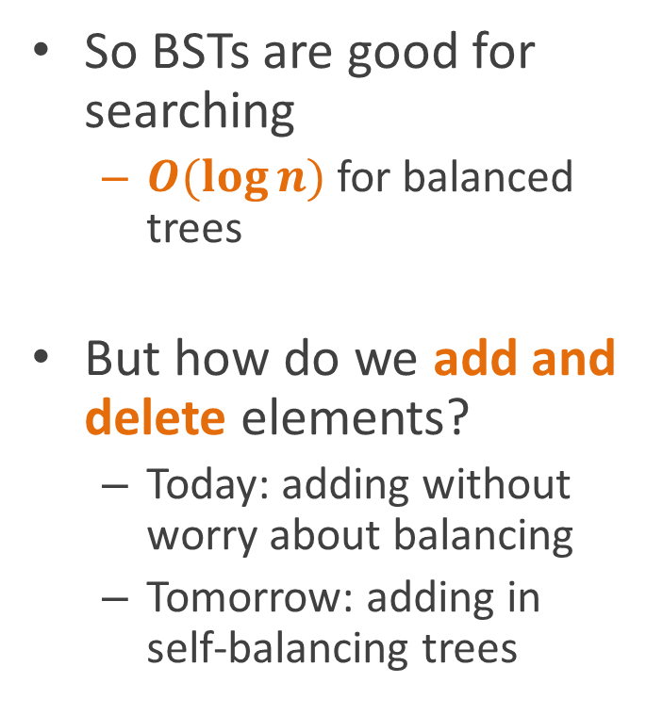
Modifying binary search trees
So BSTs are good for searching
$O(\log{n})$ for balanced trees
But how do we add and delete elements?
Today: adding without worry about balancing
Tomorrow: adding in self-balancing trees
8
2
9
1
6
4
7
3
5

Slide 33
Insertion
Two cases
Adding to empty tree
New node becomes root
Non-empty tree
Node added as child of some leaf node
Basic idea
Search for new key as if you were expecting to find it
You’ll fail (if you don’t, no need to add it!)
Add the node as a leaf of the last node examined before failing

Slide 34
Insertion code (returns root of tree)
Insert(root, int k) {
node = new BST(k);
if (root==null)
return node;
parent = FindInsertionPoint(root, k);
node.parent = parent;
if (node.key<parent.key) parent.left = node;
else
parent.right = node;
return root
}
FindInsertionPoint(n, int k) {
parent = null;
while (n != null) {
parent = n;
if (k<n.key)
n = n.left;
else
n = n.right;
}
return parent;
}

Slide 35
Analysis: how long does it take?
Insert(root, int k) {
node = new BST(k);
if (root==null)
return node;
parent = FindInsertionPoint(root, k);
node.parent = parent;
if (node.key<parent.key) parent.left = node;
else
parent.right = node;
return root
}
FindInsertionPoint(n, int k) {
parent = null;
while (n != null) {
parent = n;
if (k<n.key)
n = n.left;
else
n = n.right;
}
return parent;
}

Slide 36

Analysis: how long does it take?
Insert(root, int k) {
node = new BST(k);
if (root==null)
return node;
parent = FindInsertionPoint(root, k);
node.parent = parent;
if (node.key<parent.key) parent.left = node;
else
parent.right = node;
return root
}
FindInsertionPoint(n, int k) {
parent = null;
while (n != null) {
parent = n;
if (k<n.key)
n = n.left;
else
n = n.right;
}
return parent;
}
$$O(h)$$
$$O(h)$$

Slide 37
Deletion
Lots of case analysis
Node has no children
Set parent’s child pointer to null
Node has one child
Replace parent’s child pointer with node’s child pointer
Node has two children
“Replace” node with its successor
Find its successor
Delete its successor
Change label of node to label of old successor

Slide 38
Case 1: Node has no children
8
2
9
1
6
0
4
7
3
5

Slide 39
Case 1: Node has no children
8
2
9
1
6
0
4
7
3
5

Slide 40
Case 1: Node has no children
Set parent’s child pointer to null
And call delete on node, if using C++
8
2
9
1
6
4
7
3
5

Slide 41
Case 2: Node has one child
8
2
9
1
6
0
4
7
3
5

Slide 42
Case 2: Node has one child
Set parent’s child pointer to point at orphaned grandchild
Update grandchild’s parent pointer
8
2
9
1
6
0
4
7
3
5

Slide 43
Case 2: Node has one child
Set parent’s child pointer to point at orphaned grandchild
Update grandchild’s parent pointer
Call delete on old node if using C++
8
2
9
6
0
4
7
3
5

Slide 44
Case 3: Node has two children
8
2
9
1
6
0
4
7
3
5

Slide 45
Case 3: Node has two children
Find successor node
Claim: successor can have a most one child
Proof:
Successor is the minimum of the right subtree (by definition)
The minimum of a tree can’t have a left child
Or the child would be less than it
So it wouldn’t be minimal
So at most a right child
8
2
9
1
6
0
4
7
3
5

Slide 46
Case 3: Node has two children
Find successor node
Delete it
Easy, because it falls under case 1 or case 2
So at most one level of recursion
8
2
9
1
6
0
4
7
5

Slide 47
Case 3: Node has two children
Find successor node
Delete it
Relabel node with label of successor
8
3
9
1
6
0
4
7
5

Slide 48
Pseudocode
Delete(v) { // v for “victim”
if (v.left != null && v.right != null)
Delete2children(v);
else
Delete1or0children(v);
}
Delete2children(v) { s = Successor(v);
Delete0or1Children(s);
v.key = s.key;
}
Delete1or0children(v) {
child = v.left, if non-null,
else v.right
if (child != null)
child.parent = v.parent;
if (v.parent != null) {
if (v.parent.left == v)
v.parent.left = child;
else
v.parent.right = child; }
}
Note: this code finesses the case where we delete the root of the tree, however it’s easier to read. See the CLR book for (ugly) code that handles root deletion

Slide 49
Analysis: how long do these take?
Delete(v) { // v for “victim”
if (v.left != null && v.right != null)
Delete2children(v);
else
Delete1or0children(v);
}
Delete2children(v) { s = Successor(v);
Delete0or1Children(s);
v.key = s.key;
}
Delete1or0children(v) {
child = v.left, if non-null,
else v.right
if (child != null)
child.parent = v.parent;
if (v.parent != null) {
if (v.parent.left == v)
v.parent.left = child;
else
v.parent.right = child; }
}
Note: this code finesses the case where we delete the root of the tree, however it’s easier to read. See the CLR book for (ugly) code that handles root deletion

Slide 50
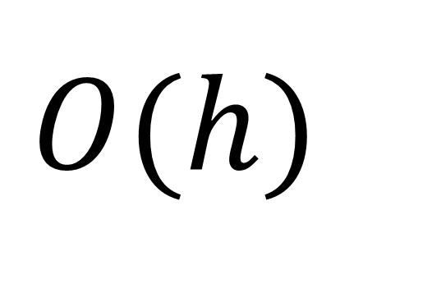
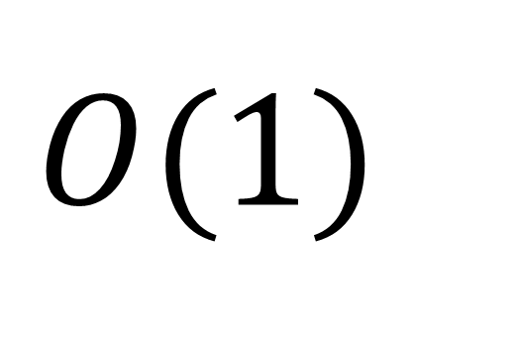
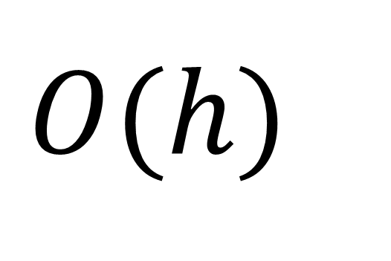
Analysis
Delete(v) { // v for “victim”
if (v.left != null && v.right != null)
Delete2children(v);
else
Delete1or0children(v);
}
Delete2children(v) { s = Successor(v);
Delete0or1Children(s);
v.key = s.key;
}
Delete1or0children(v) {
child = v.left, if non-null,
else v.right
if (child != null)
child.parent = v.parent;
if (v.parent != null) {
if (v.parent.left == v)
v.parent.left = child;
else
v.parent.right = child; }
}
$$O(h)$$
$$O(1)$$
$$O(h)$$
Note: this code finesses the case where we delete the root of the tree, however it’s easier to read. See the CLR book for (ugly) code that handles root deletion

Slide 51
Reading
Introduction to Algorithms (“CLR book”)
Third edition: chapter 12
Second edition: chapter 13
Don’t need to read section on randomly built binary search trees

